Slide 1

VIRTUAL
AVATAR

Slide 2
Problem Statement:
Build a unique Virtual Avatar (2D/3D) for the Bank, to create a Differentiated experience for Account opening and relationship management. Activities like Account opening, KYC (Know Your Customer), form filing can be automated with Virtual experiences.
An avatar is a graphical representation of a user or the user's character or persona. Avatars can be 2D/3D icons in Internet forums and other online communities, where they are also known as profile pictures or user pic. The solution should have the avatars with fictional characteristics to gain better social acceptance or ease social interaction.
OBJECTIVE:
Development of Step-by-Step Form
Branching of What details to be filled as per the selections.
Auto fill Repeating Information
Voice (to support multiple India Languages) and Virtual Keyboard based interactions.
Clicking Documents with HL camera (Need to understand the process where we can save these documents to
keep them safe after clicking)

Slide 3
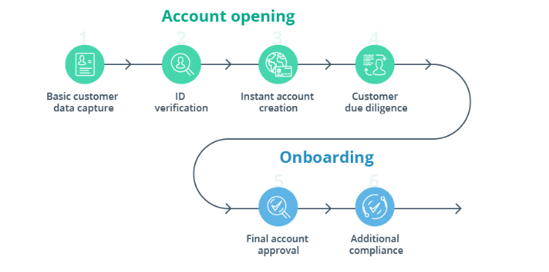
WORKING METHODOLOGY:

Slide 4
CODE TOOLS USED:
VISUAL STUDIO CODE
GOOGLE COLAB
EXISTING SOLUTION:
The solution have the avatars with fictional characteristics to gain better social acceptance or ease social interaction. Build a unique Virtual Avatar (2D/3D) for the Bank, to create a Differentiated experience for Account opening and relationship management. An avatar is a graphical representation of a user or the user's character or persona. Avatars can be 2D/3D icons in Internet forums and other online communities, where they are also known as profile pictures or user pic.

Slide 5
SOLUTION:
VIRTUAL AVATAR FOR BANK ACCOUNT OPENING
Step 1: Capture basic customer data
Modern customers expect highly personalized Amazon-style digital experiences. Offer a warm greeting with a survey-based on boarding sequence. Collect some basic personal information and line up several product offers.
What types of customer data should you capture?
Primary goal: save, borrow, or grow income
Main priorities: high interest, low banking fees, high rewards/ cashback, etc.
Monthly income: suggest several ranges
Past relationship with your bank: yes/no

Slide 6
Step 2: Verify ID
Once the customer makes a choice, offer them an easy way to apply and submit all the required documents. Leverage native smart phone functionality (camera, location-based services, biometrics, etc.) to capture the minimal KYC information:
ID credentials — selfie + photo (or video) of a passport, driver’s license, or other photo ID document
Proof of address — uploaded directly or synced automatically from a utility services provider or telecom company
Step 3: Instantly create an account
Once the customer provides the minimal required information, you can instantly issue mobile banking login credentials. But is it safe to do so?
Step 4: Customer due diligence
While your new customer enjoys a quick account tour, you can conduct further background checks… in the background.

Slide 7
Step 5: Final account approval
Once you’ve verified all of the customer’s information and assigned a low risk score, grant full account access.
Extend a welcome kit providing further onboarding prompts regarding account top-up options and the card ordering process. Prompt users to set up all key account security features such as:
two-factor authentication or biometric log-in
card PIN and transaction limits
privacy settings
Step 6: Additional compliance
Create an ongoing KYC process that will be triggered by certain events:
Large deposits
Unusual cross-border transfers
Frequent cryptocurrency trading, etc.
Rely on big data analytics to determine when additional checks are required and develop custom KYC policies for every customer based on:
their location, considering local compliance requirements
occupation/type(s) of income
common transaction types and spending patterns
past records with your bank or partner services

Slide 8
CONCLUSION:
Yes, it sounds harsh. But 80% of heritage financial institutions may disappear by 2030 unless they innovate with technology. Digital account opening can become the first step on the journey toward larger core business transformations.
As Millennials and Gen Z consumers are becoming the dominant customer segment with the most wealth, there’s not much wiggle room left. This cohort will not wait 7+ days when they need to open an account. Or settle for lackluster, extensive KYC procedures. In a few taps, they’ll switch to a competitor offering a faster, more streamlined account opening experience. And you don’t want that to happen, do you?

Slide 9
THANK YOU

